Slide 1
Using TRIPS-Flexibilities as a leverage to improve access to HIV and HCV medicines in Ukraine
Author: Kondratyuk Sergiy
All-Ukrainian Network of People Living with HIV/AIDS (CO “100 Percent Life”)

Slide 2
TDF/FTC/EFV, ABC, ABC/3TC
PRICE REDUCTIONS IN UKRAINE

Slide 3
NEGOTIATIONS, PATENT OPPS AND CL THREATS RESULTS
Repeated
Request to
ViiV re ABC
license extension
Request to
ViiV re MPP
DTG, ABC license
expansion
Filing motion
in GSK vs Hetero
patent litigation
on preparation
of patent
invalidation
MSD
Non-Enforcement
Letter
DTG license
extension
to Ukraine
2014
2015
2016
2017
Compulsory
license
threat
meeting with MoH,
MSD, GSK,
ABBVIE, JNJ
ViiV
Non-Enforcement
Letter
Procurement
of generic
ABC, ABC/3TC
TDF/FTC/EFV, DTG
#StopTheSilenceAIDS2018 #TransitionPlan
#StopTheSilenceAIDS2018

Slide 4
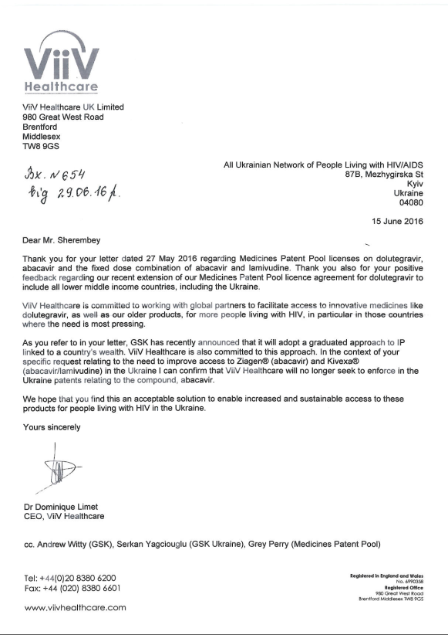
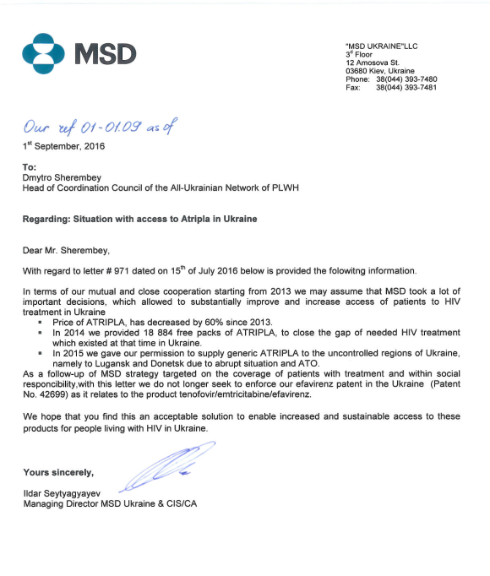
NEGOTIATIONS, PATENT OPPS AND CL THREATS RESULTS
#StopTheSilenceAIDS2018 #TransitionPlan

Slide 5
NEGOTIATIONS, PATENT OPPS AND CL THREATS RESULTS
TDF/FTC/EFV
ABC/3TC
ABC
INITIAL
PRICE
PRICE AFTER
ADVOCACY INTERVENTIONS
493$
354$
295$
MSD (TDF/FTC/EFV)
AND VііV (ABC/3TC, ABC) PROVIDED
NON-ENFORCEMENT LETTERS
96$
148$
130$
#StopTheSilenceAIDS2018

Slide 6
NEGOTIATIONS, PATENT OPPS AND CL THREATS RESULTS
TDF/FTC/EFV
ABC/3TC
ABC 300
$12,6 mln
ANNUAL
SAVINGS
+7 000 PATIENTS
MSD (TDF/FTC/EFV)
AND VііV (ABC/3TC, ABC) PROVIDED
NON-ENFORCEMENT LETTERS
$0,9 mln
ANNUAL
SAVINGS
$0,4 mln
ANNUAL
SAVINGS
+71 000 PATIENTS
+2 800 PATIENTS
#StopTheSilenceAIDS2018

Slide 7
SOFOSBUVIR
PATENT OPPOSITION IN UKRAINE

Slide 8
DUE TO FILED IN 2015 PATENT OPPOSITIONS:
TEMPORARY COMPETITION ON SOF APPEARED IN 2016
Q1 2016
GILEAD SOF PRICE
FOR MOH UKRAINE
1350$
Q2 2016
Pharco price
Q3 2016
Gilead price drop
750$
702$
Q4 2017
Post-license
price
???
#StopTheSilenceAIDS2018 #TransitionPlan

Slide 9
SOF: PATENT STATUS IN UKRAINE
APPLICATIONS FOR TWO MAIN PATENTS
NOT FILED IN UKRAINE:
MODIFIED FLUORINATED NUCLEOSIDE ANALOGUES (WO2005003147A2)
NUCLEOSIDE PHOSPHORAMIDATE PRODRUGS (WO2008121634A2)
OPPOSED APPLICATIONS:
APPLICATION № А 2012 12444 «NUCLEOSIDEFOSFORAMIDATES» (NATIONAL PHASE OF РСТ/US2011/030725), WHICH CONSIDERS THE PROCESS OF PRODUCING SOF AS AN ACTIVE SUBSTANCE
DIVISIONAL APPLICATION А2013 11603
APPLICATION № А2013 01999 ON THE ISSUE OF THE PATENT FOR THE INVENTION "METHODS OF OBTAINING DIASTEROMERLY PURE PHOSPHORAMATEDATE PRODRUGS"
#StopTheSilenceAIDS2018 #TransitionPlan

Slide 10
SOF: MAIN BLOCKING PATENT APPLICATION
PATENT APPLICATION
NO. A201212444 ‘NUCLEOSIDE PHOSPHORAMIDATES’
FILED IN 31 MARCH 2011
WO2011123645 / PCT/US2011/030725 - A PROCESS PATENT FOR THE PREPARATION OF THE ACTIVE COMPOUND. THE PATENT COVERS A CRYSTALLINE STRUCTURE OF NUCLEOSIDE PHOSPHORAMIDATES, A GENERAL STRUCTURAL FORMULA (MARKUSH STRUCTURE) OF NUCLEOSIDE PHOSPHORAMIDATES, AND A PROCESS OF PREPARATION OF THE ACTIVE COMPOUND.
CLAIMS:
CRYSTAL FORM,
PHARMACEUTICAL COMPOSITION,
ITS COMBINATION WITH OTHER ANTI-VIRAL DRUGS AND PROTEASE INHIBITORS,
USE OF CRYSTAL FORM FOR PREPARATION OF MEDICINE;
USING THE CRYSTAL FORM FOR TREATMENT OF HEPATITIS C,
METHOD OF TREATMENT BY THE ADMINISTRATION OF THE EFFECTIVE DOSE OF THE CRYSTALLINE FORM
#StopTheSilenceAIDS2018 #TransitionPlan

Slide 11
SOF: PRE-GRANT OPPOSITION IN UKRAINE
COUNTERARGUMENTS TO
GILEAD’S PATENT АPPLICATION 201212444
NOT NOVEL:
Disclosed in the previous application in the patent of the USA, international applications and article of one of the inventors on the patent application;
NO INVENTIVE STEP:
The value of the angle of reflection of the crystalline structure is a characteristic parameter of the polymorphic modification of any crystal compound, which were determined in the process of known measurement of the crystal structure. The value of the angle of reflection 2Θ is obvious for a specialist in this area, and can be determined, for example, by receiving a known crystalline compound of the powder in accordance with the D1-D4 data (PRIOR ART) and its inspection by X-ray diffraction on the powder
Production of pharmaceutical drugs with the use of specific polymorphic modification of crystalline compounds obvious for a specialist who knows data on crystalline compound
#StopTheSilenceAIDS2018 #TransitionPlan

Slide 12
TIMELINE OF SOF PRE-GRANT OPPOSITION
2nd
PRELIMINARY
REFUSAL
25.05.2015
FINAL REFUSAL
OF UKR PATENT OFFICE
07.2017
APPELATE BOARD
DISMISSED
APPEAL FROM GILEAD
1th
PRELIMINARY
REFUSAL
03.02.2015
3nd
PRELIMINARY
REFUSAL
25.09.2015
2015
2017
FILING OPPOSITION
30.04.2015
SUBMISSION
OF ADDITIONAL
ARGUMENTS
10.08.2015
VOLUNTARY
LICENSE
EXPANSION
ANNOUNCED
24.08.2017
#StopTheSilenceAIDS2018 #TransitionPlan

Slide 13
DUE TO FILED IN 2015 PATENT OPPOSITIONS:
TEMPORARY COMPETITION ON SOF APPEARED IN 2016
Q1 2016
GILEAD SOF PRICE
FOR MOH UKRAINE
1350$
Q2 2016
Pharco price
Q3 2016
Gilead price drop
750$
702$
Q2 2018
Voluntary
license
price
60$
#StopTheSilenceAIDS2018 #TransitionPlan

Slide 15
#StopTheSilenceAIDS2018
#FreeSentsov

